Slide 1



Predicting Solar Power Output Using Linear Regression

Slide 2

Learning Objectives
The objective of this project is to understand and apply linear regression techniques to predict solar power generation based on historical data. By the end of this project, learners should be able to:
Develop a linear regression model to predict solar power generation from relevant features such as time of day, weather conditions, and historical power data.
Evaluate model performance using error metrics like Mean Absolute Error (MAE) and understand the implications of prediction accuracy.
Analyze the impact of data preprocessing, feature selection, and model evaluation on prediction quality.
Gain hands-on experience with machine learning concepts, including data splitting, training and testing, and model generalization.
Understand the practical applications of predictive models in renewable energy systems and their role in optimizing energy usage.
GOAL
To use Linear Regression to find the difference between predicted and actual value of power generated.
Source :
www.freepik.com/

Slide 3




Tools and Technology used
Jupyter Notebook
Python
Scikit learn (for machine learning in python)
Excel (for data collection)
Linear Regression model

Slide 4
Methodology
Understand the Dataset: Inspect the data structure, types, and initial statistics using .head() and .describe(). Check for missing values and data types.
Clean the Dataset: Handle missing values by either imputing or dropping them. Remove duplicates. Correct data types as needed (e.g., converting categorical data to category type).
Exploratory Data Analysis (EDA): Visualize the data with histograms, box plots, and scatter plots. Analyze correlations using heatmaps and pair plots to identify relationships between features.
Model Building: Split data into training and testing sets using train_test_split(). Choose an appropriate machine learning model (e.g., Linear Regression, Random Forest) and train it on the training data.
Model Evaluation: Make predictions on the test set. Evaluate model performance using metrics like MAE, MSE, or R-squared for regression, or accuracy/F1-score for classification.

Slide 5
Problem Statement:
As renewable energy sources like solar power become increasingly vital for sustainable energy production, accurate forecasting of solar power generation is essential for optimizing energy grid management, resource allocation, and consumption. Traditional methods of prediction are often limited by external factors such as weather patterns, geographical location, and time of day. The challenge lies in developing a model that can reliably predict solar power generation based on historical data. This project aims to predict solar power generation using a linear regression model. The goal is to minimize the prediction error and achieve high accuracy in forecasting solar power output, as measured by the Mean Absolute Error (MAE). Accurate predictions can help energy providers plan for fluctuating energy demands, ensure efficient grid management, and reduce reliance on non-renewable energy sources.

Slide 6
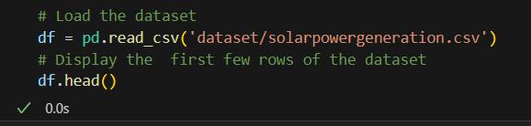




Solution:
Collection of data : A list of 21 historical data has been collected from a region to train the machine learning and test for its accuracy.
Exploratory Data Analysis and Data Cleaning : The data received are checked for any duplicated or null values which can cause problems during the training of the machine.

Slide 7
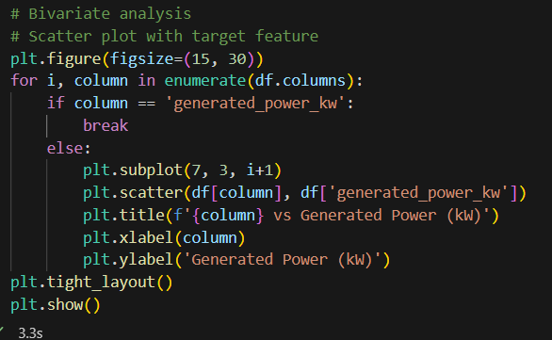
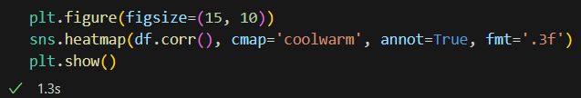
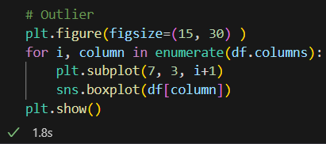
Solution:
Data Visualization : The data collected are represented in a graph to find the most efficient value and the correlation between the historical data collected to produce the output.

Slide 8
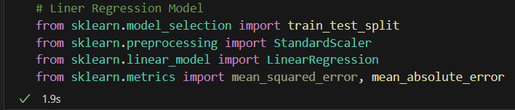

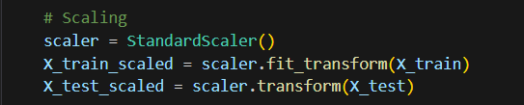

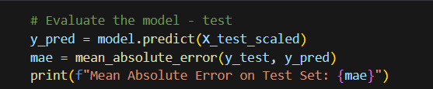
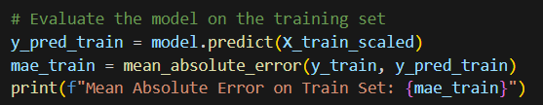
Solution:
Training the Machine : Using the historical data collected and verified, the Machine is trained using Linear Regression to find the predicted amount of energy generated.
Testing : By finding the mean absolute error of the predicted and actual values we can check how good the machine is in predicting

Slide 9
Screenshot of Output:
Output of the predicted mean absolute error by the machine
Output of the actual mean absolute error

Slide 10
Conclusion:
the linear regression model used to predict solar power generation has shown fairly consistent performance, with the Mean Absolute Error (MAE) for the test set being 391.79 and for the training set being 392.42. The slight difference in MAE between the two sets suggests that the model is generalizing well, without significant overfitting or underfitting. Although the MAE values indicate an average prediction error of around 391.8 units, there is room for improvement in model accuracy, possibly through feature engineering, parameter tuning, or exploring more advanced machine learning techniques.

